Slide 1
REACT JS Project
Mandeep Shergill
24th April 2024

Slide 2
Database
Firebase
MySQL
JSON API
ASP.NET API

Slide 3
Tools Used
Visual Studio Code .
React.js
Json connection .
Photoshop for logo.
Icons from bootstrap.
Draw.io and smart draw.

Slide 4
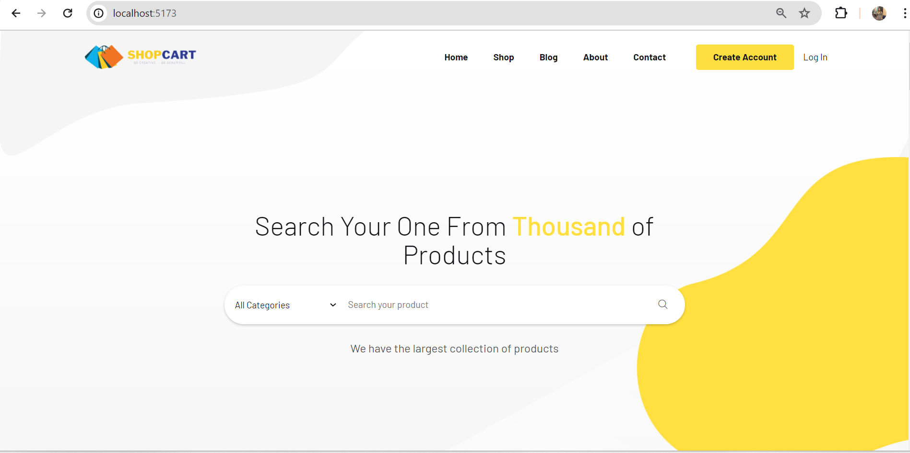
Home

Slide 5
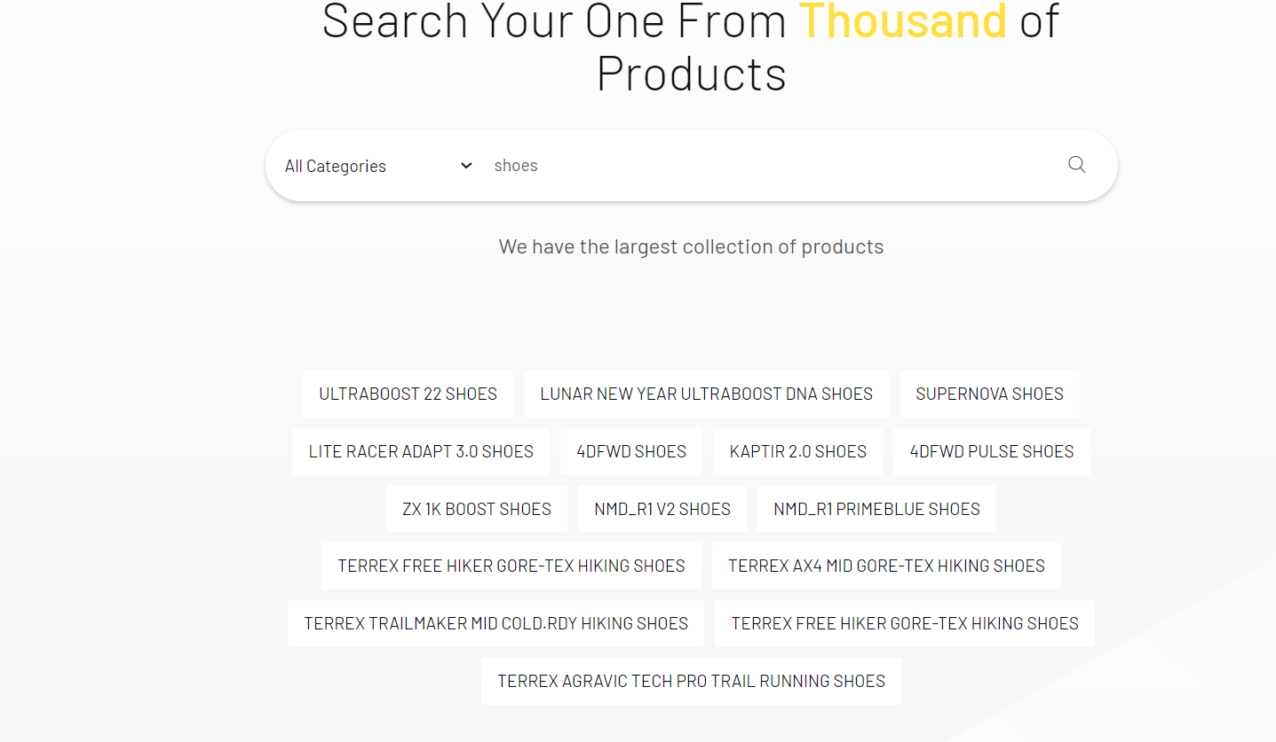
Searching Product on Home Page

Slide 6

Categoried

Slide 7
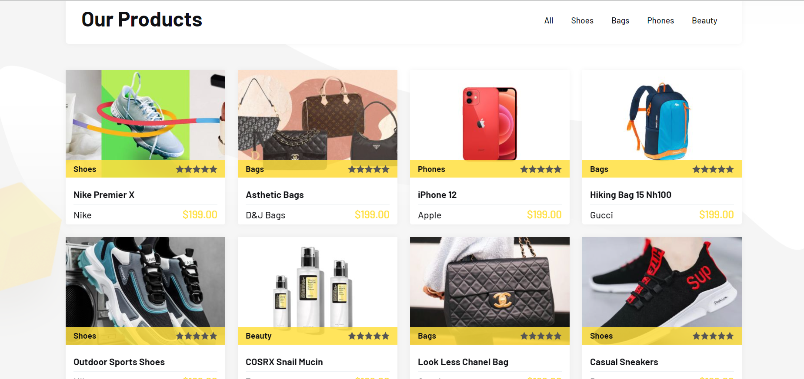
Products

Slide 8
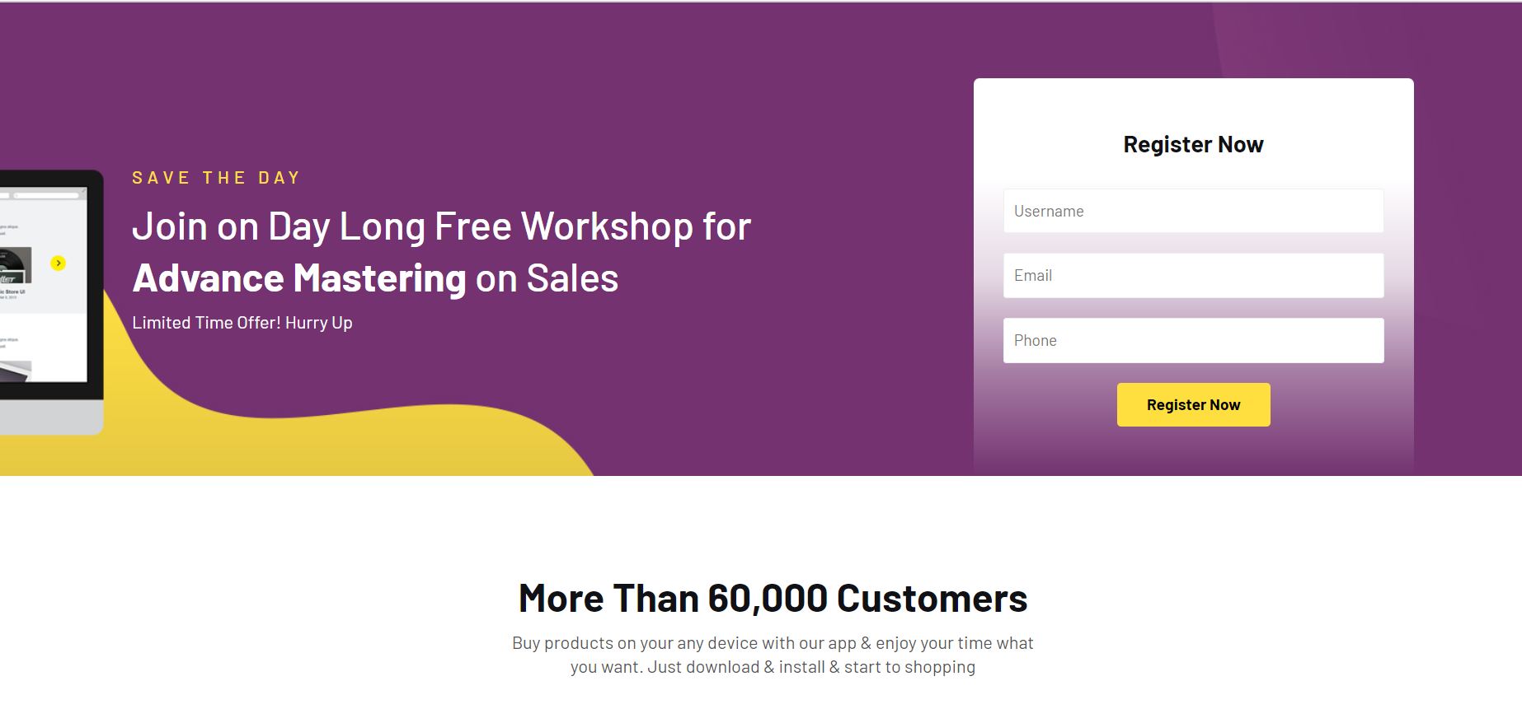
Home - Continued

Slide 9
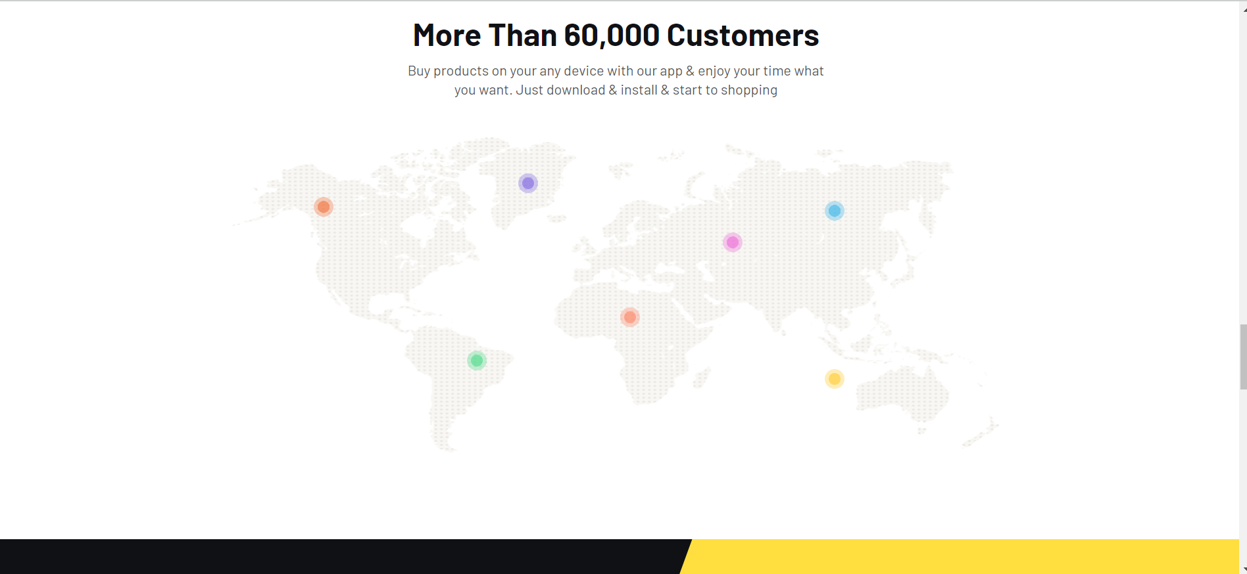
Home Continued

Slide 10

Home Continued

Slide 11
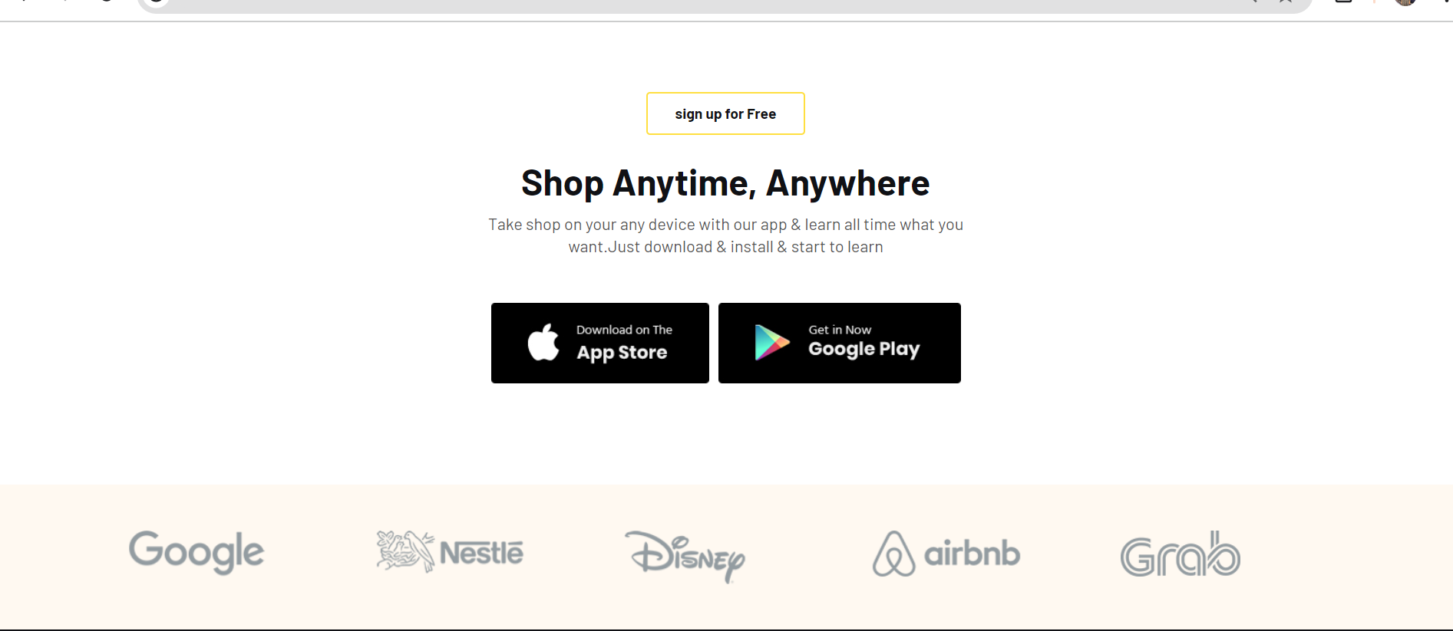
Home Continued

Slide 12
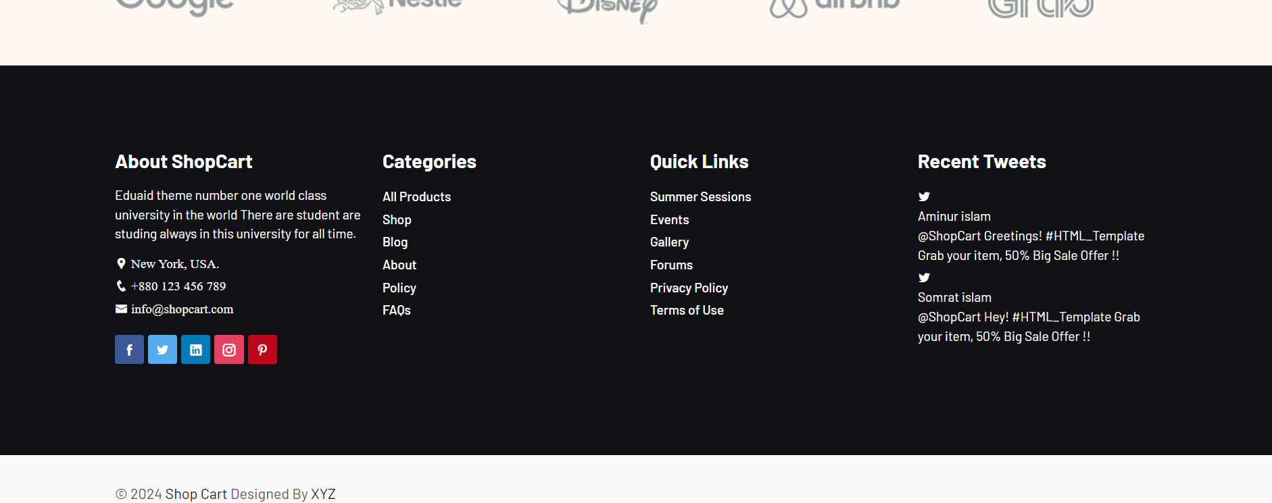
Footer Page

Slide 13
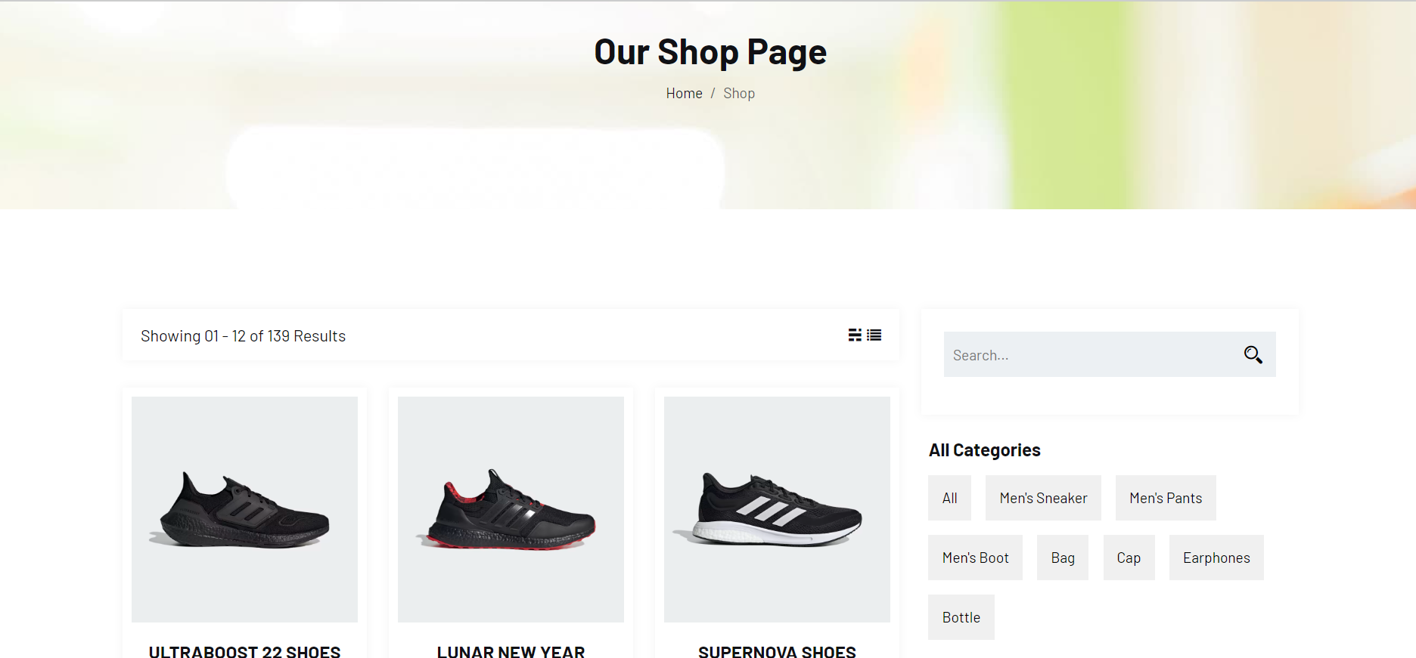
Shop- Product

Slide 14
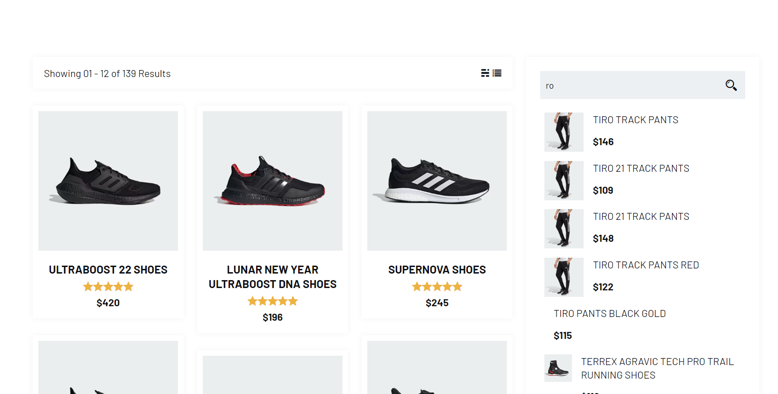
Products - Page

Slide 15
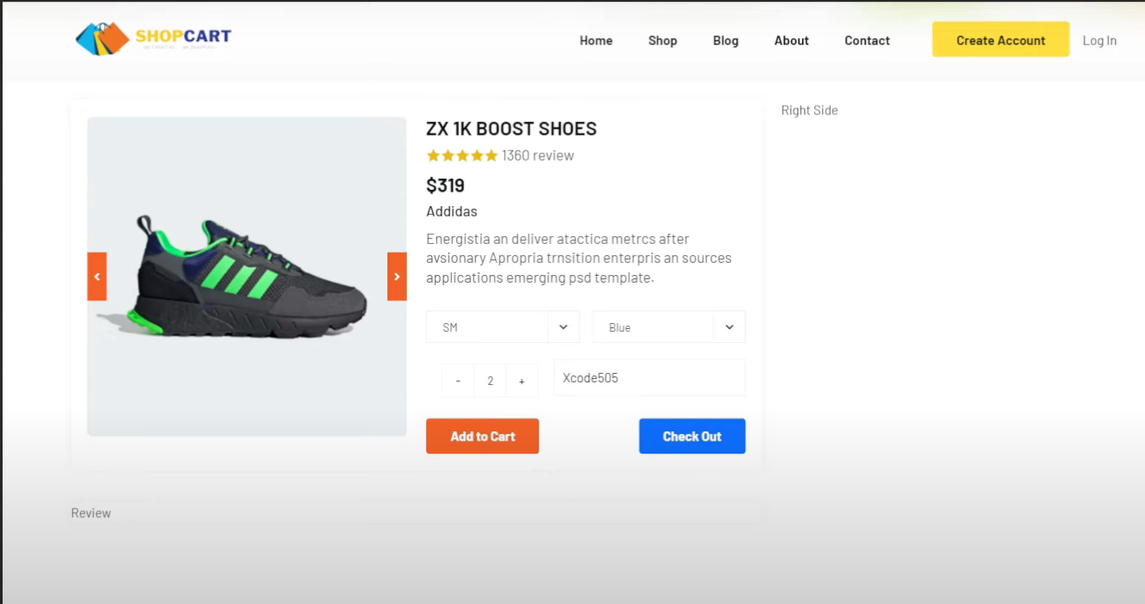
SHOP Page

Slide 16
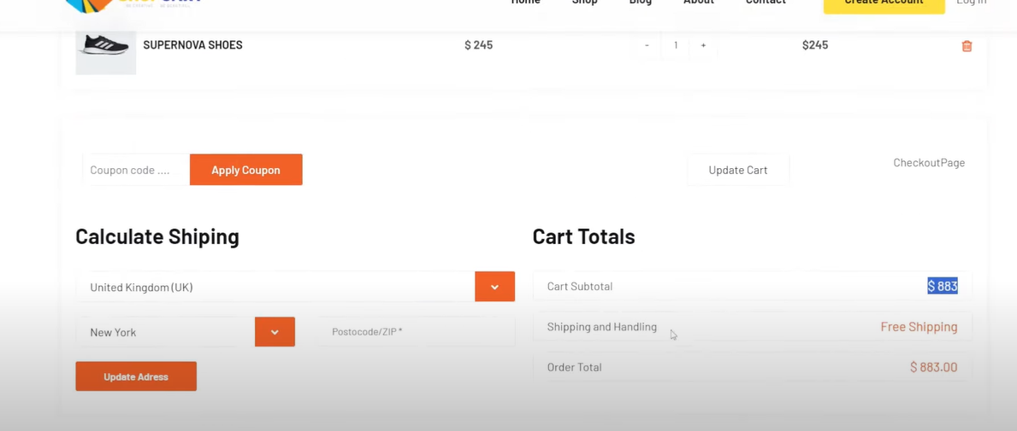
Checkout

Slide 17

About

Slide 18
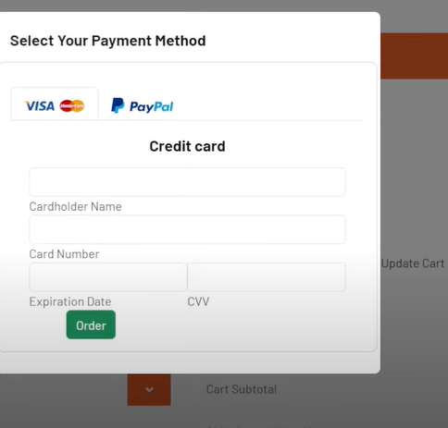
Third Party Checkout

Slide 19
END
THANK You

